Slide 1
MIDLAND PARK PUBLIC SCHOOLS GRADES 7-12 1:1 CHROMEBOOK PROGRAM UPDATE FOR MIDLAND PARK BOARD OF EDUCATION FEBRUARY 23, 2016
Notes:
Dr. C

Slide 2
Thank You!
Board of Education
Administration
Faculty & Staff
Parents & Students
Committee Members
Notes:
Nick

Slide 3
Chromebook Rollout
June 22, 2015 - 7-12th grade teachers receive Chromebooks and initial PD
September 2, 2015 - All district teachers receive PD on Chromebooks and GAfE
September 15 & 16, 2015 - 7-12th grade students receive overview of 1:1 Chromebook program policies and procedures and are assigned a device
January 18, 2016 - Teachers receive follow-up PD on advanced features of Chromebooks and GAfE
Notes:
Melissa

Slide 4
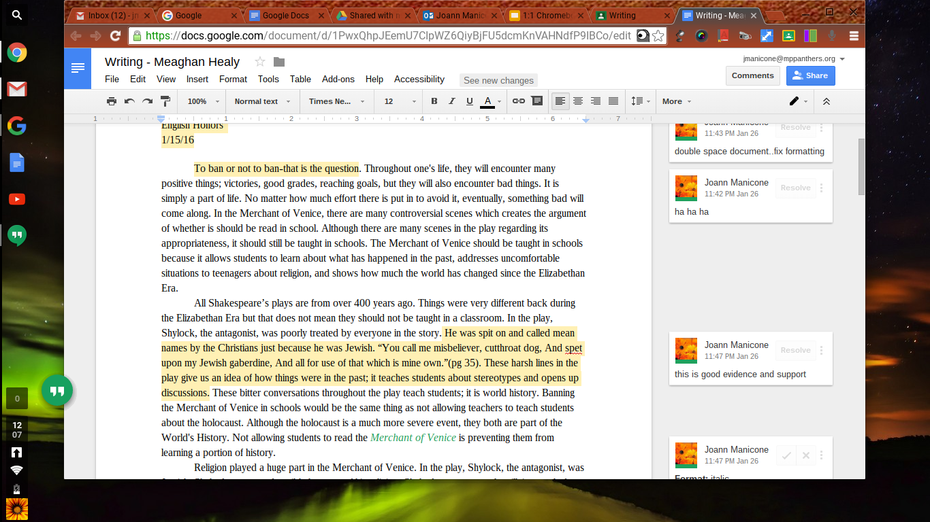
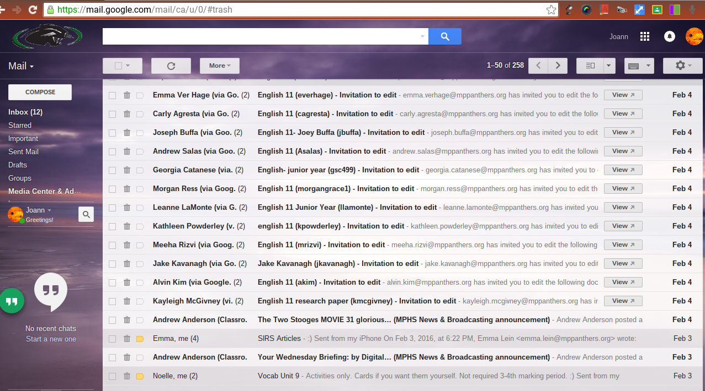
Impact on the ELA Classrooms
Student / teacher dialogue has been reinvented using Google Docs and Gmail in the ELA classroom
Writing tasks (with teacher sidebar dialogue) are enhanced.
Students and teachers communicate via email and GC daily, fostering independence and real-world skills
Notes:
Joann Manicone
Google classroom- instant communication...email, dialogue
Writing tasks with instant feedback…(Docs)
Group collaboration (Slides)
Literature- Newsela(nonfiction)
Research- Noodletools
Vocabulary games...quizizz, kahoot
SAT prep work- Khan Academy
class time used efficiently as no more carts to care for
no more flash drives, lost documents, overwritten files, safer environment…
pedagogy, instructional class time- first and last five minutes...useful and focused

Slide 5
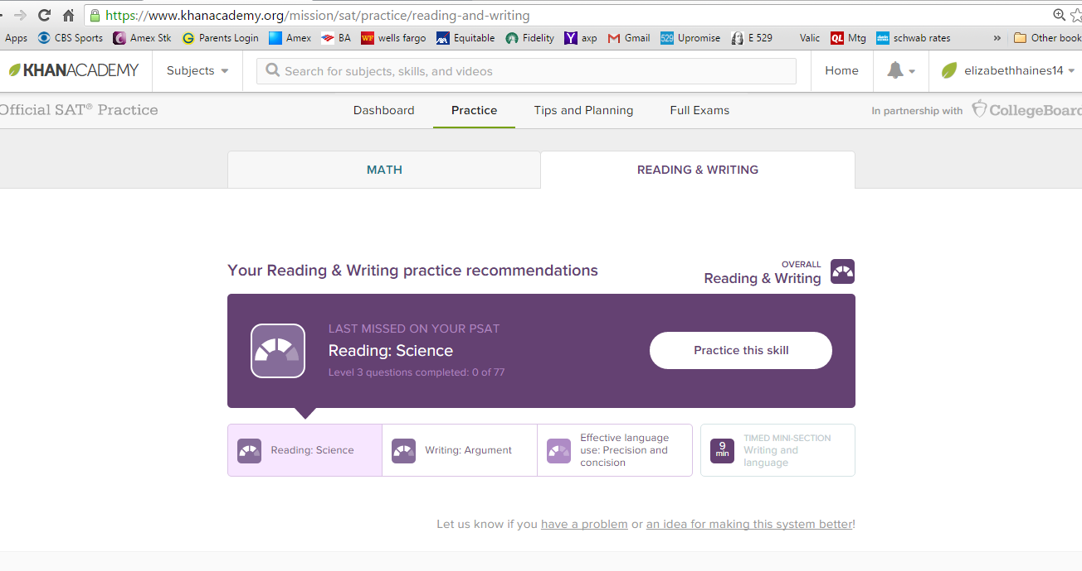
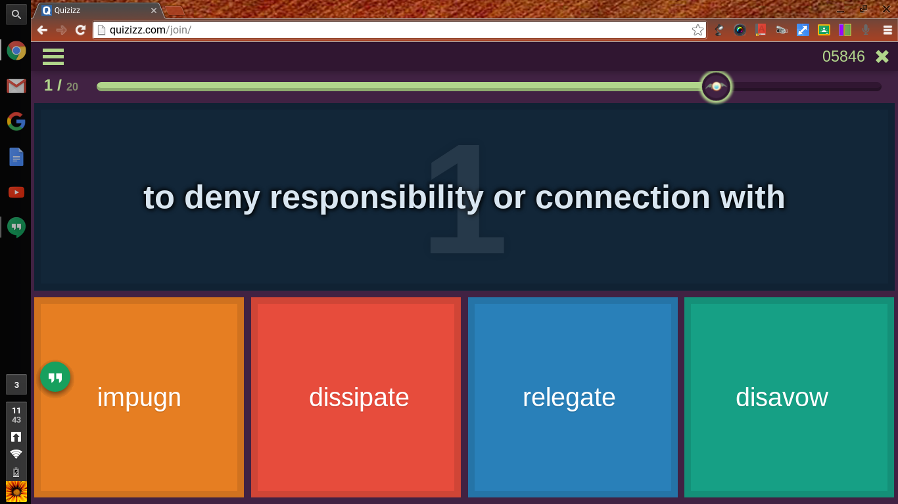
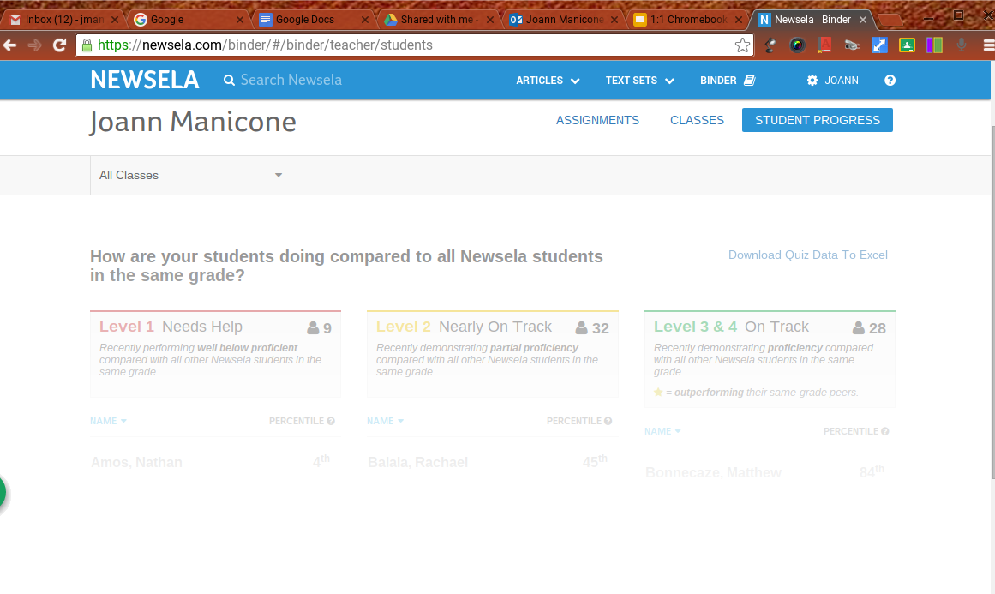
Impact on the ELA Classrooms
SAT prep work- Khan Academy
Vocabulary games...quizizz, kahoot
Literature- Newsela (nonfiction)
Student collaboration using Google Slides for presentations
Notes:
Joann Manicone

Slide 6
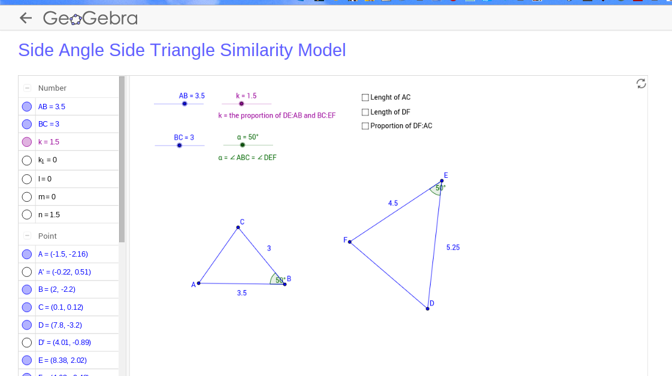
Impact on the Math Classrooms
Visual Labs - students can “see” the concepts
Notes:
Danielle Vandenberghe

Slide 7
Impact on the Math Classrooms
Math YouTube videos - Helps reinforce concepts taught
Do Now through Classroom -
Do Nows through Classroom - Great for the traveling teacher.
Paperless Homework
Extra tools and textbook always available for students
Notes:
Danielle Vandenberghe

Slide 8
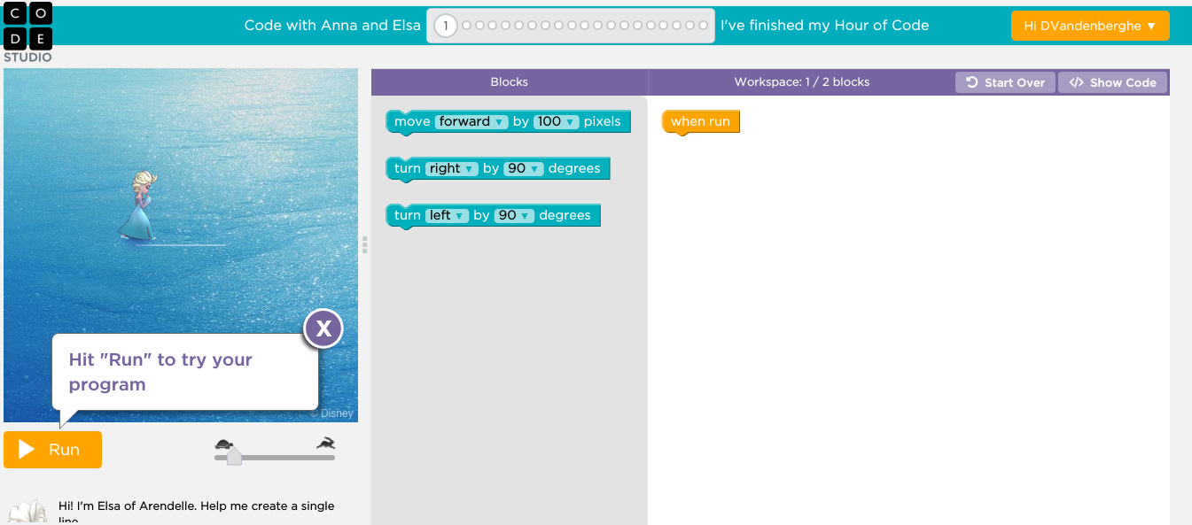
Impact on the Computer Classroom
Students able to practice coding through fun interactive games.
Share articles and have discussions through Classroom
Online Tests
Notes:
Danielle Vandenberghe

Slide 9
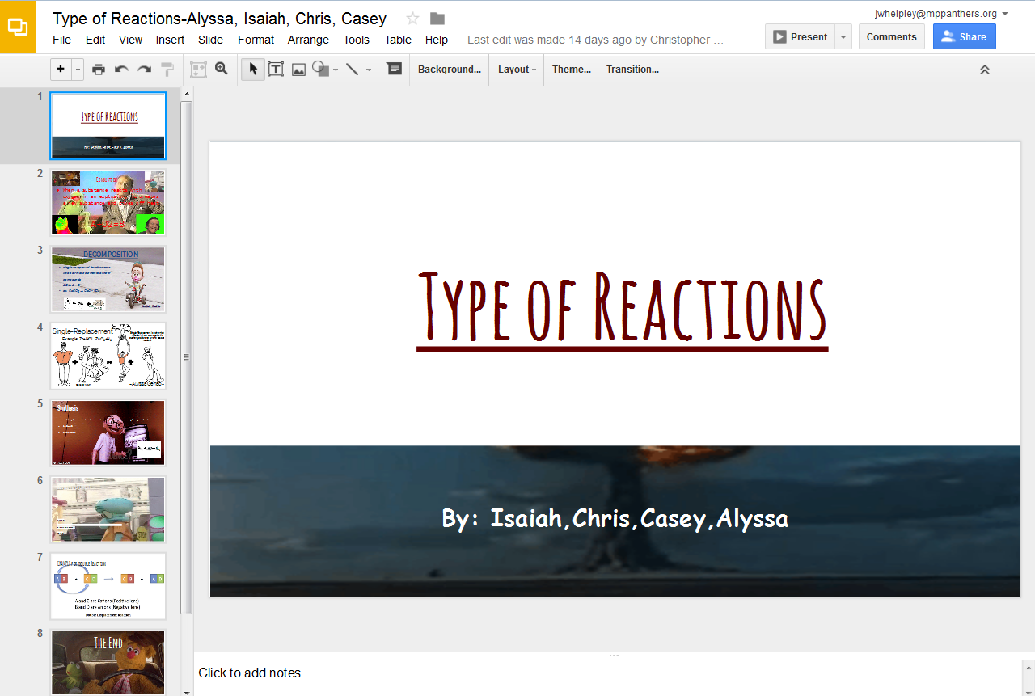
Impact on the Science Classrooms
Collaborative Presentations - Google Slides/Prezi
Notes:
Jason Whelpley

Slide 10
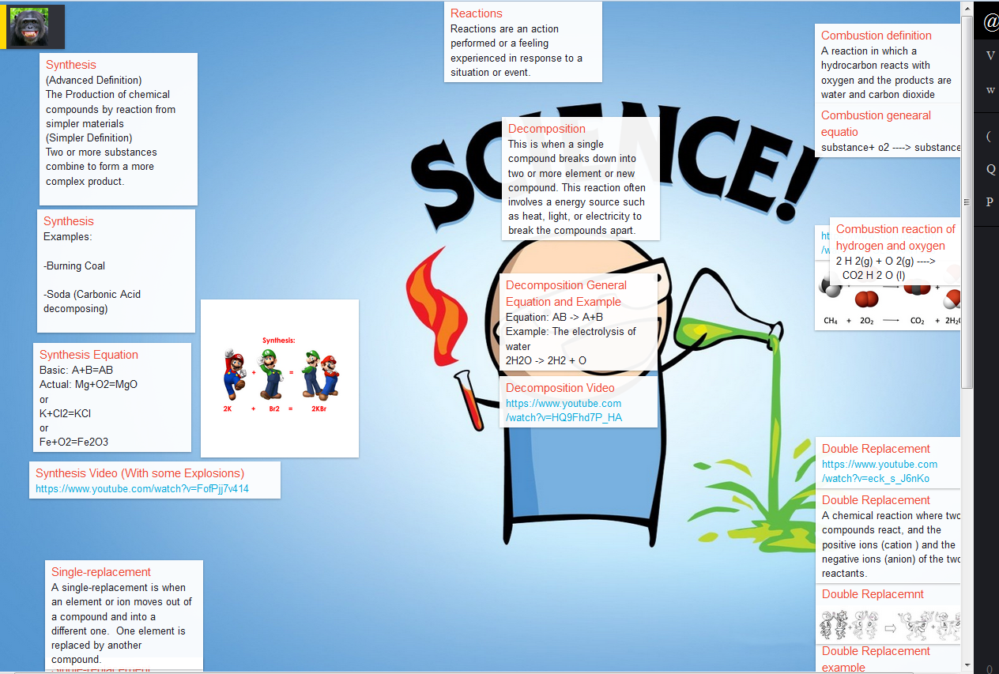
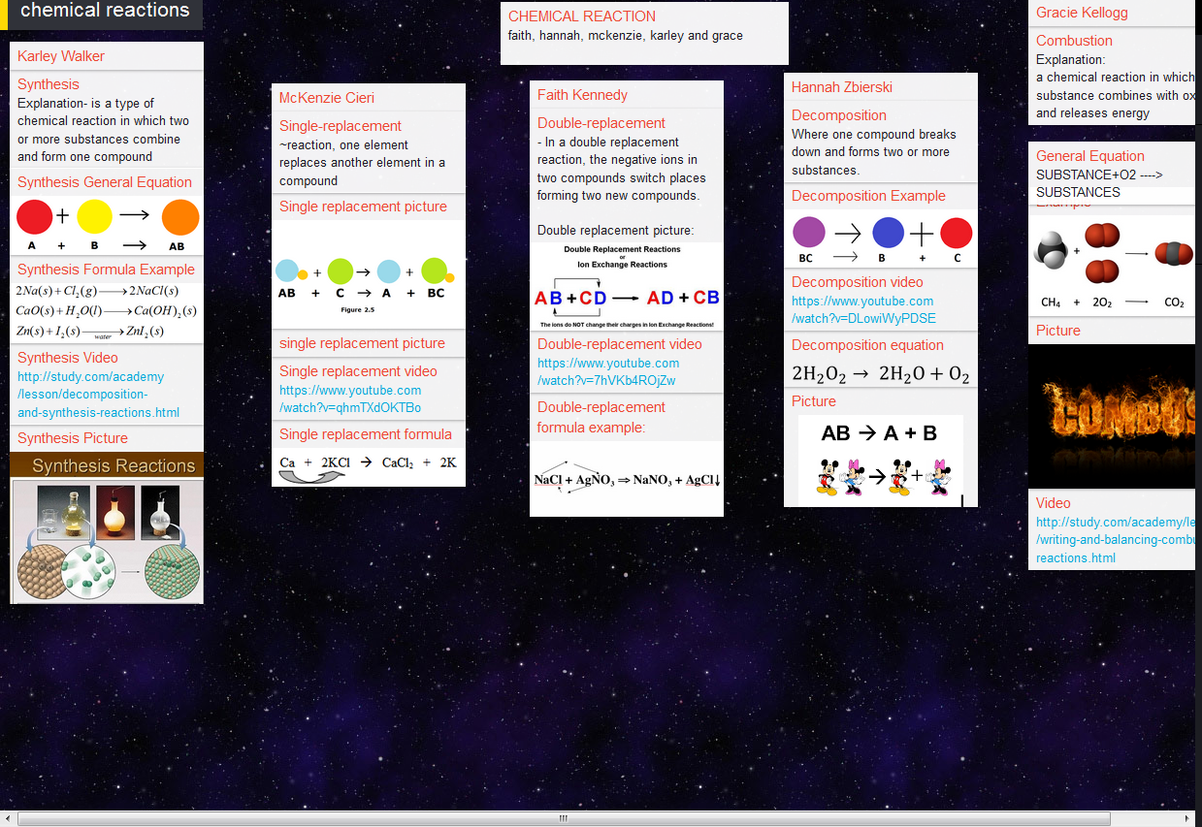
Impact on the Science Classrooms
Interactive Display Boards - Padlet.com
Notes:
Jason Whelpley

Slide 11
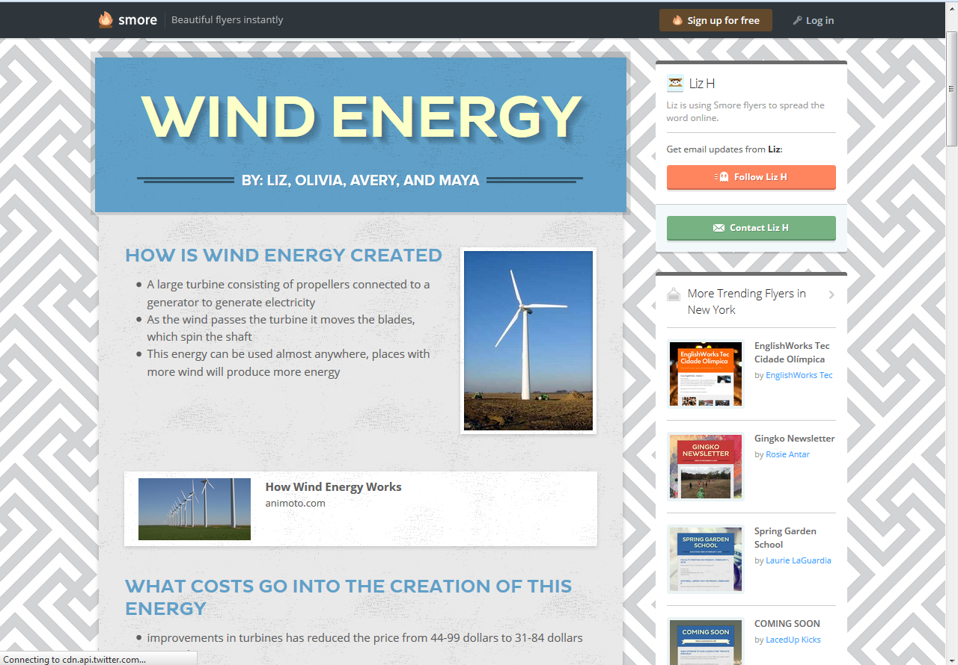
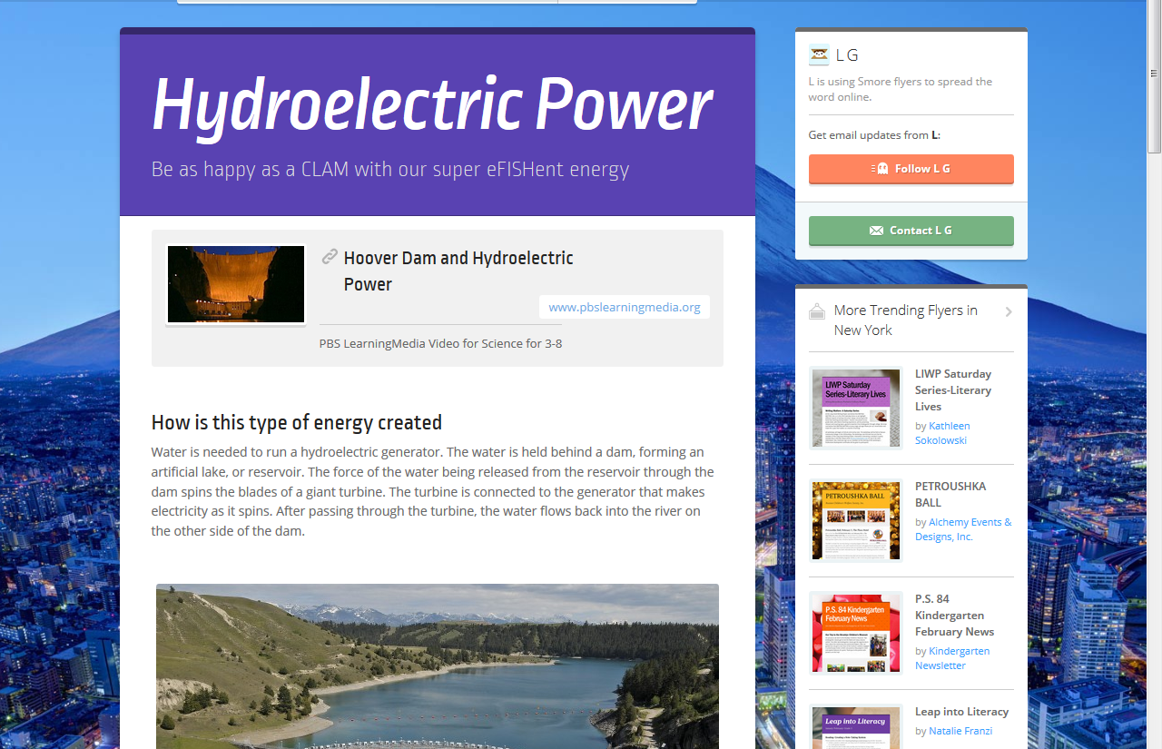
Impact on the Science Classrooms
Public Service Announcements - Smore.com
Notes:
Jason Whelpley

Slide 12
Impact on the Science Classrooms
Genius Hour - Chromebook
Notes:
Jason Whelpley

Slide 13
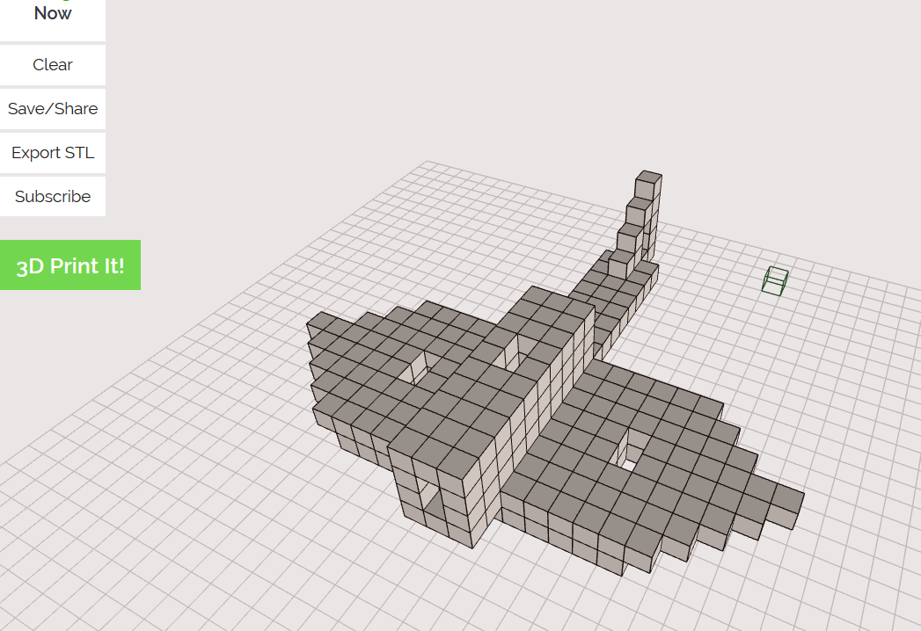
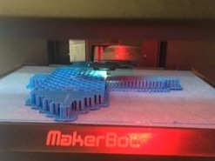
Impact on the Science Classrooms
Genius Hour Projects - Makethingsnow.com/beta
Notes:
Jason Whelpley

Slide 14
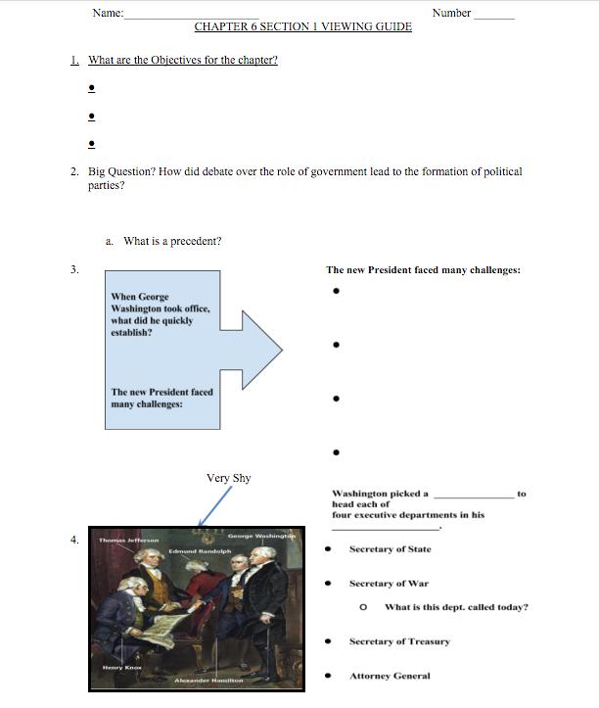
Impact on the Social Studies Classrooms
Flipping the Classroom
Notes:
Dino Eliopoulos

Slide 15
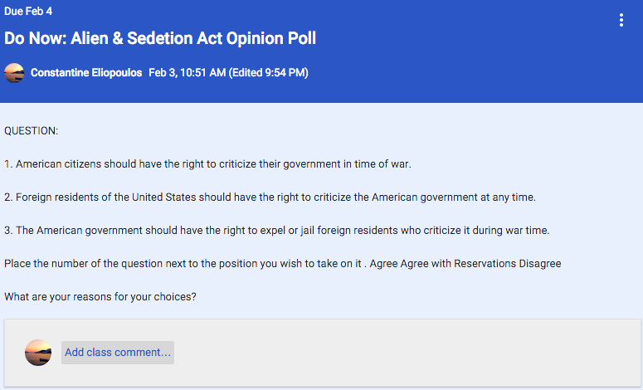
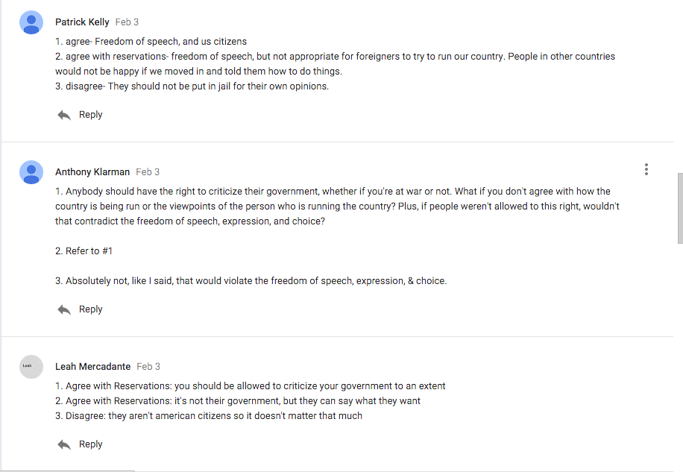
Impact on the Social Studies Classrooms
Engaging Interactive (Ice Breaker) “Do Now” Google Classroom
Notes:
Dino Eliopoulos

Slide 16
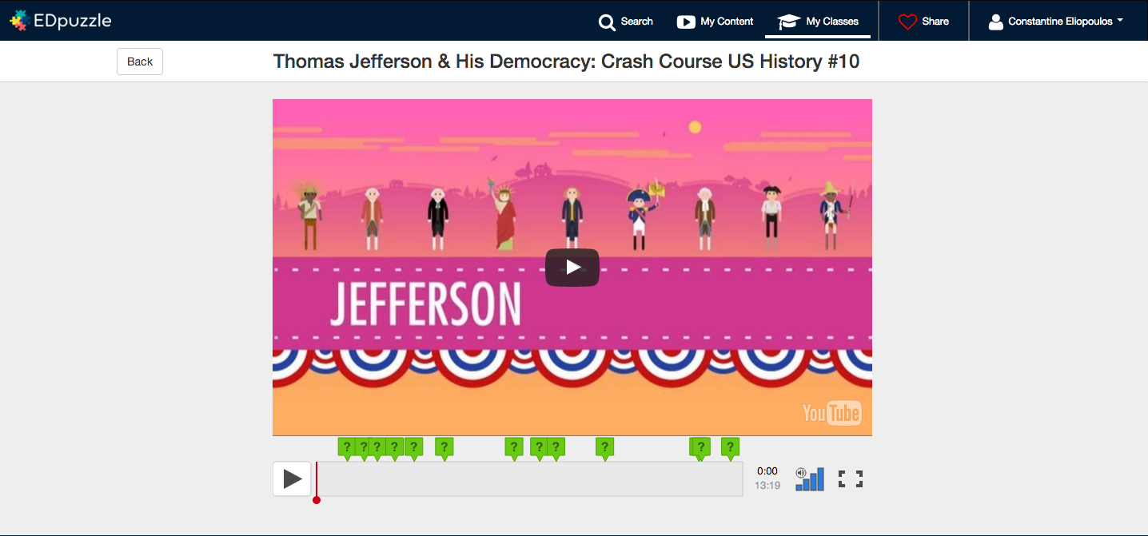
Impact on the Social Studies Classrooms
Using Google Classroom Applications - EDpuzzle
Notes:
Dino Eliopoulos

Slide 17
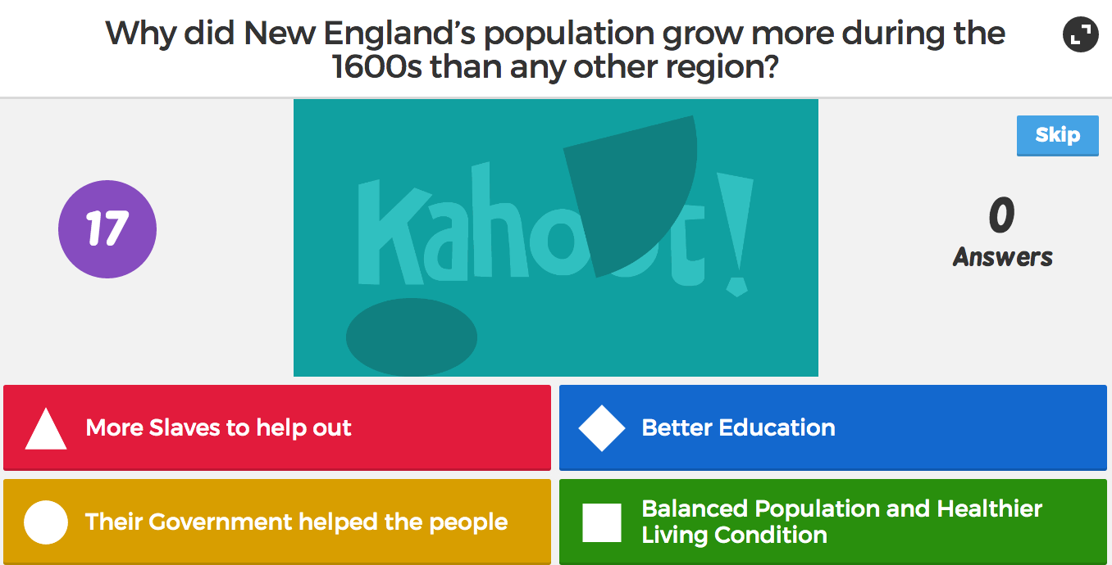
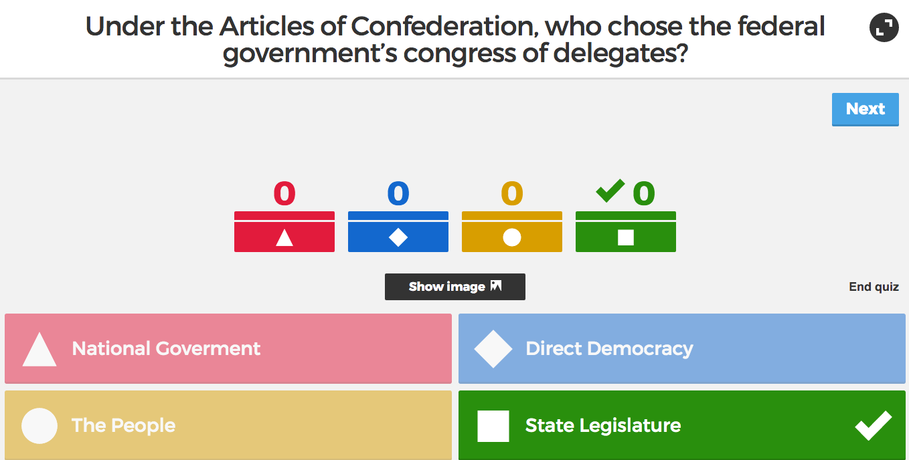
Impact on the Social Studies Classrooms
Interactive Review Games
Notes:
Yana Seminara

Slide 18
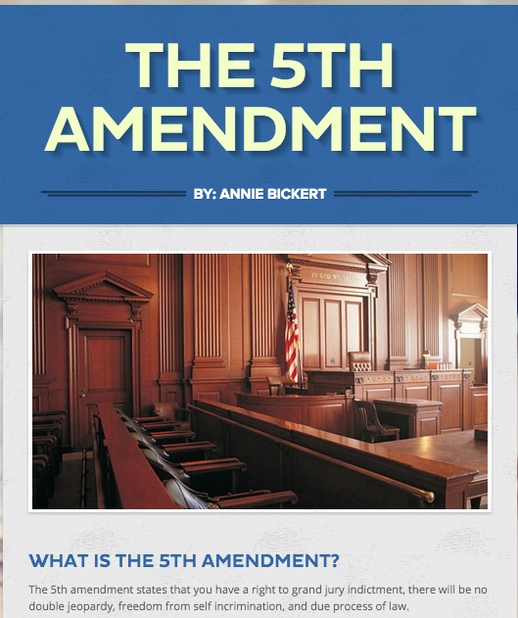
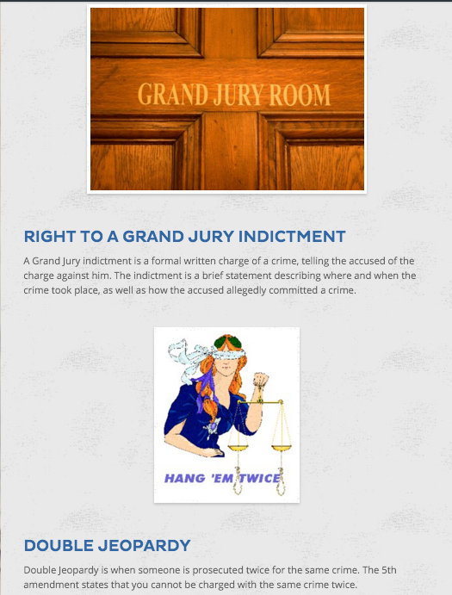
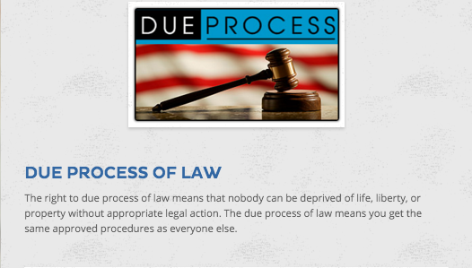
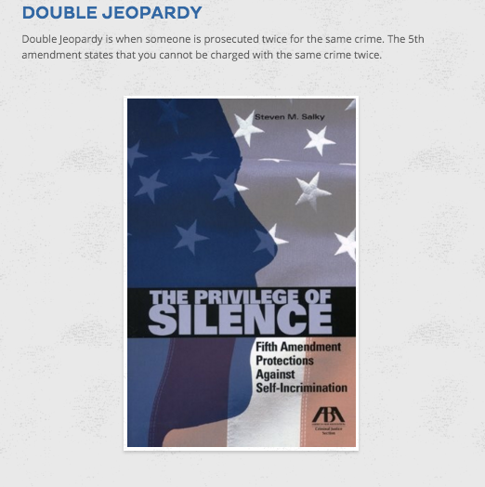
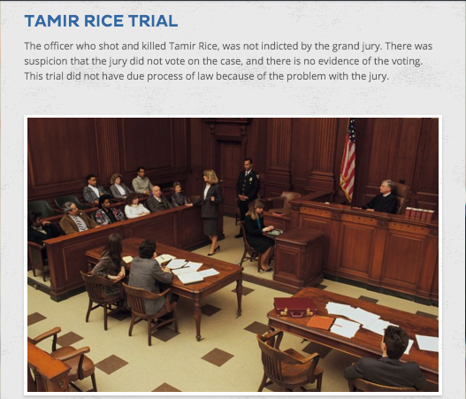
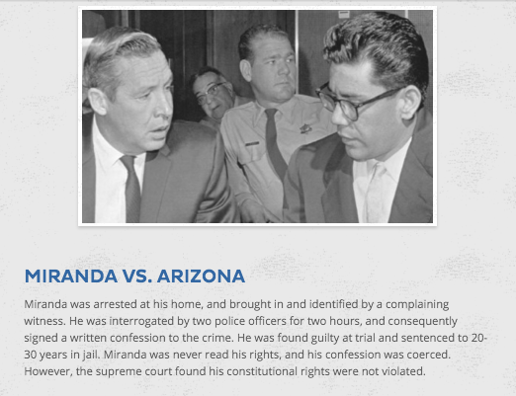
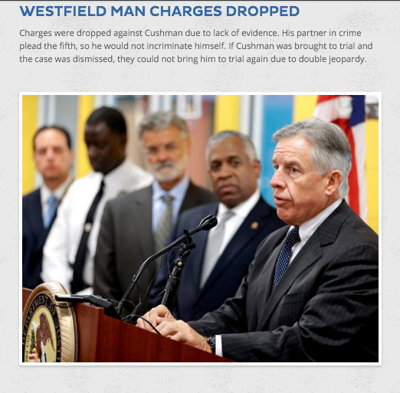
Impact on the Social Studies Classrooms
Digital Posters https://www.smore.com/qpqry
Notes:
Yana Seminara

Slide 19
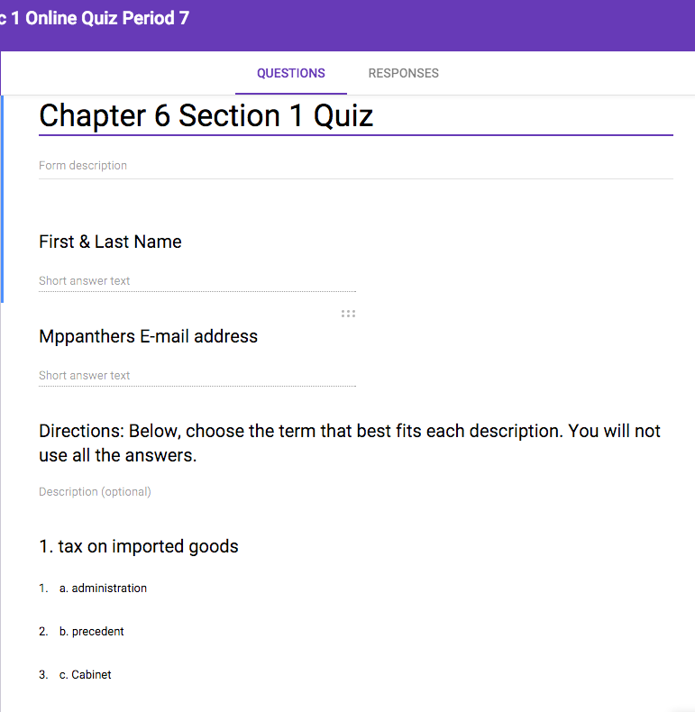
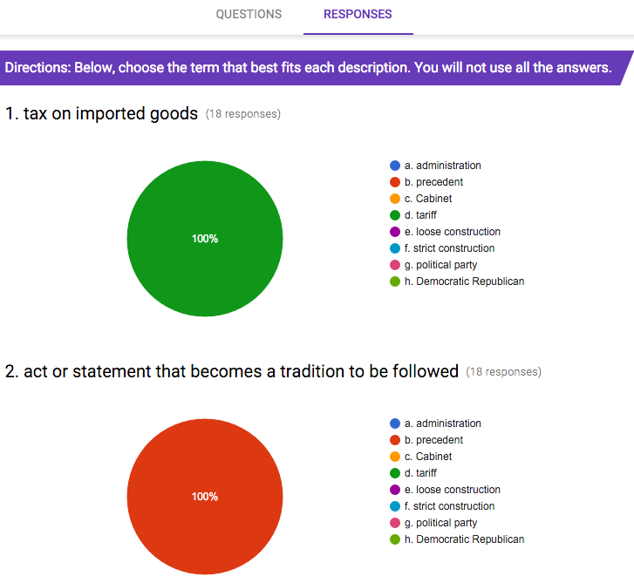
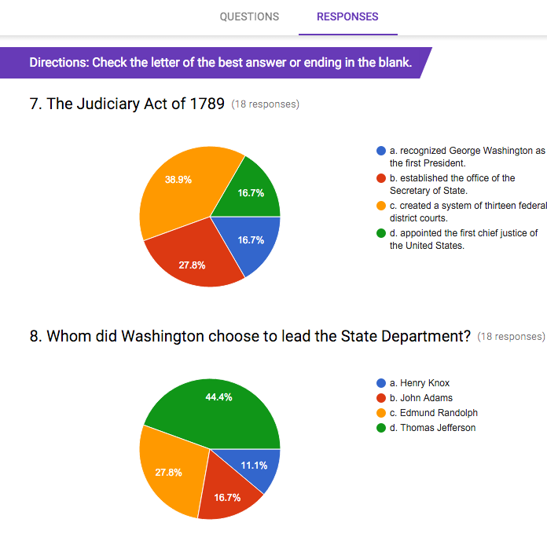
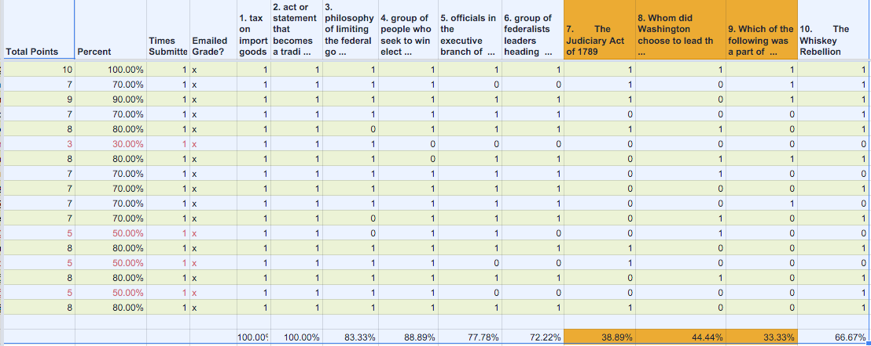
Impact on the Social Studies Classrooms
Online Assesment
Online Tests / Quizzes
Analytics / Flubaroo
Notes:
Yana Seminara

Slide 20
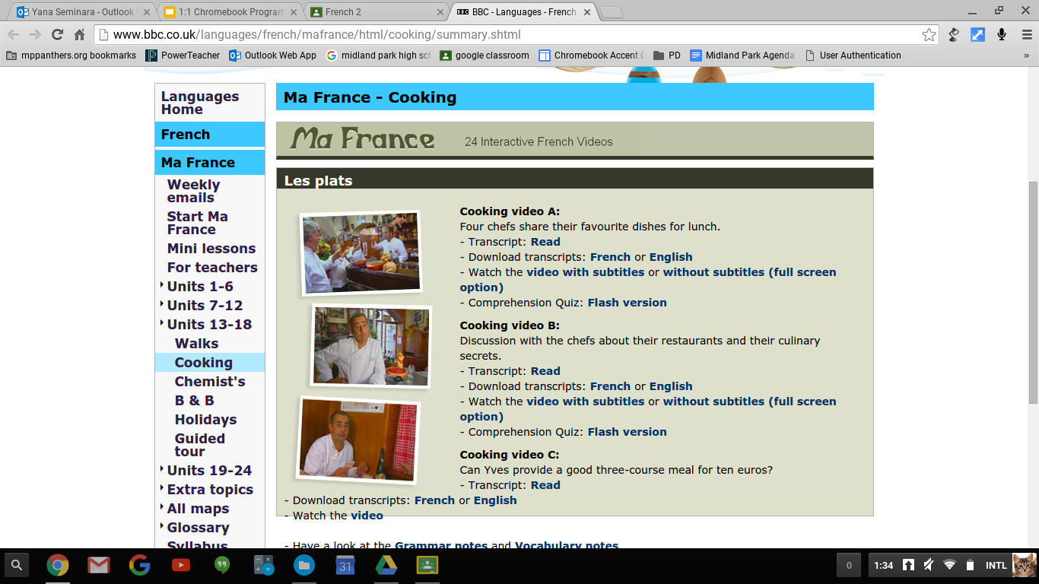
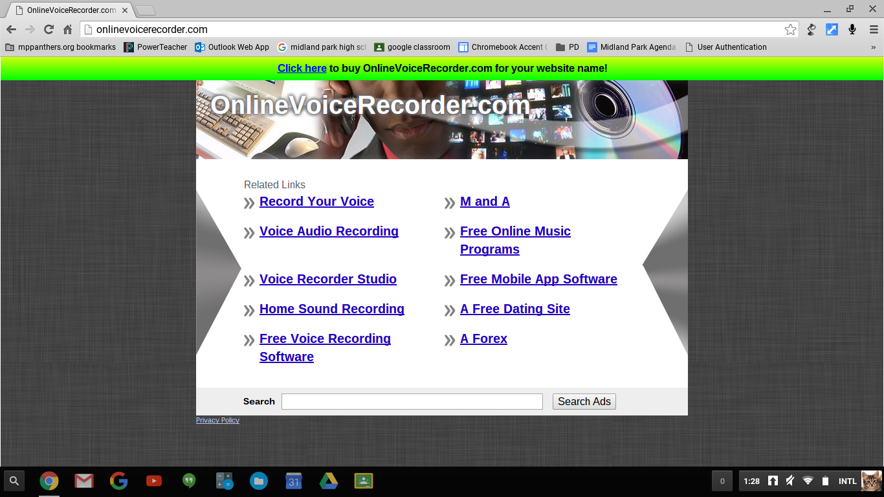
1:1 in World Langauge Classroom: apps and websites
1:1 allows to differentiate instruction putting students in control of their learning, increasing accountability

Slide 21
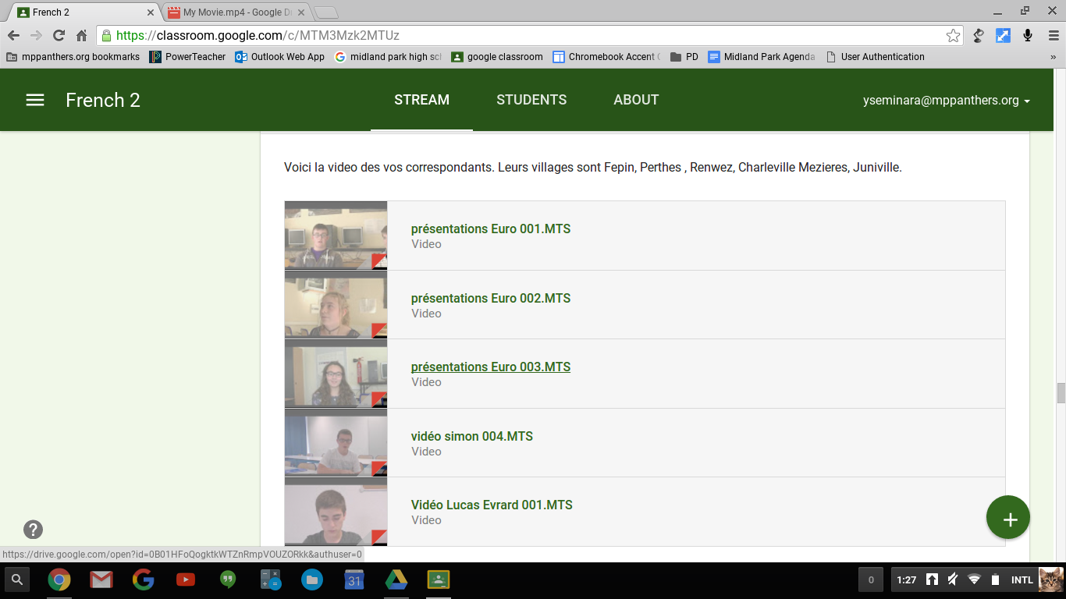
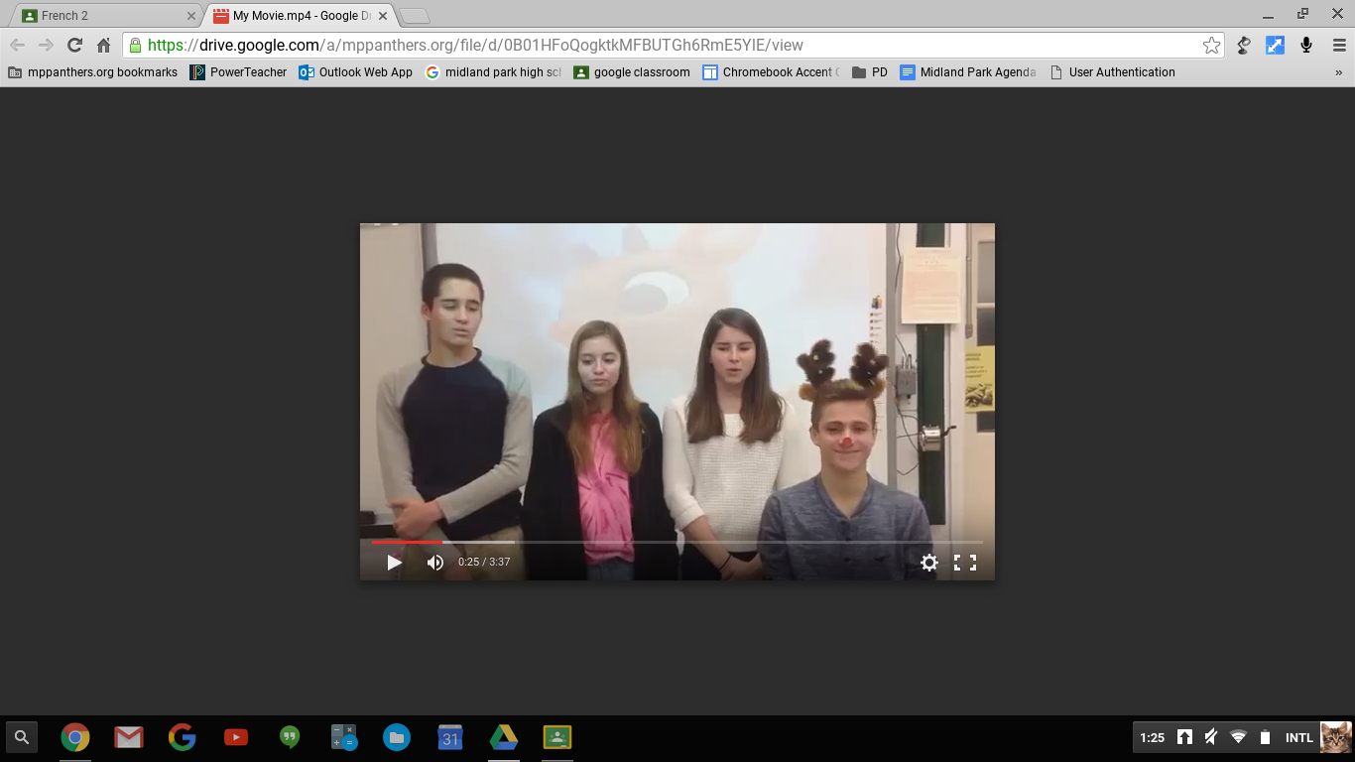
1:1 in World Language Classroom: partner school exchanges
1:1 allows for more meaningful, authentic experiences: i.e. video exchanges with a school in France

Slide 22
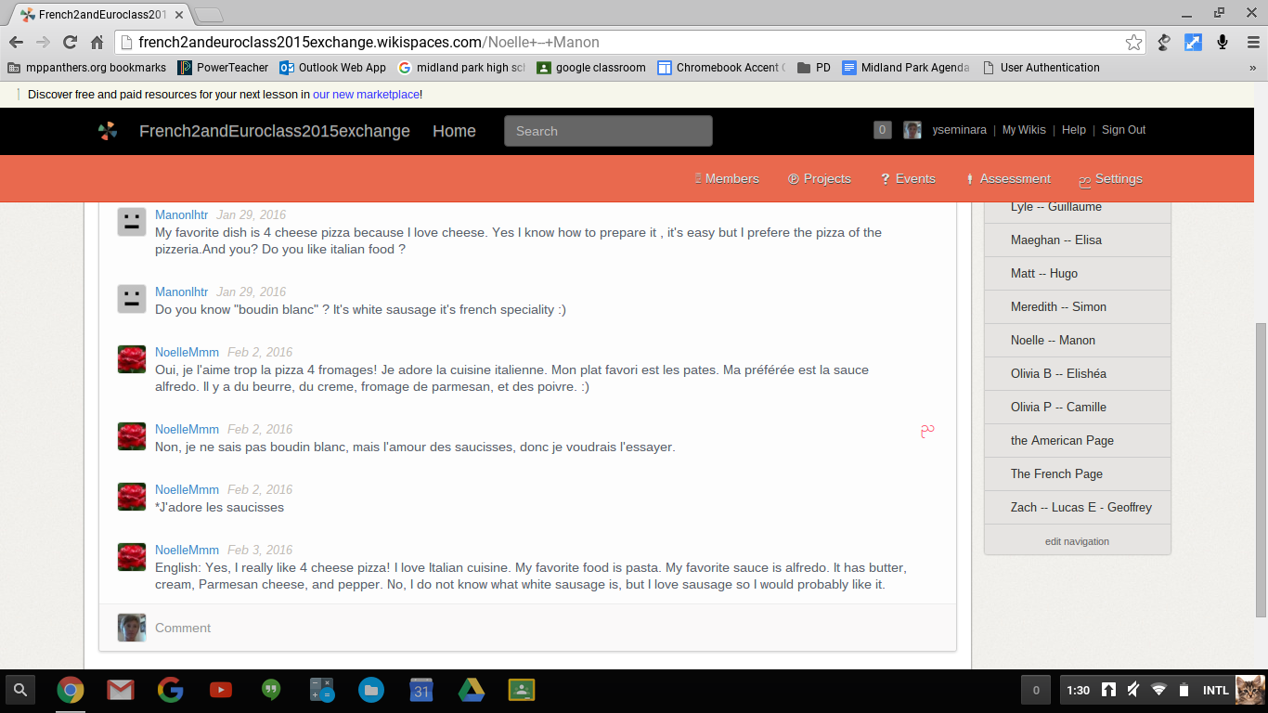
1:1 in World Language Classroom: wikispaces
Students keep ongoing discussions with their French penpals comparing various cultural aspects

Slide 23
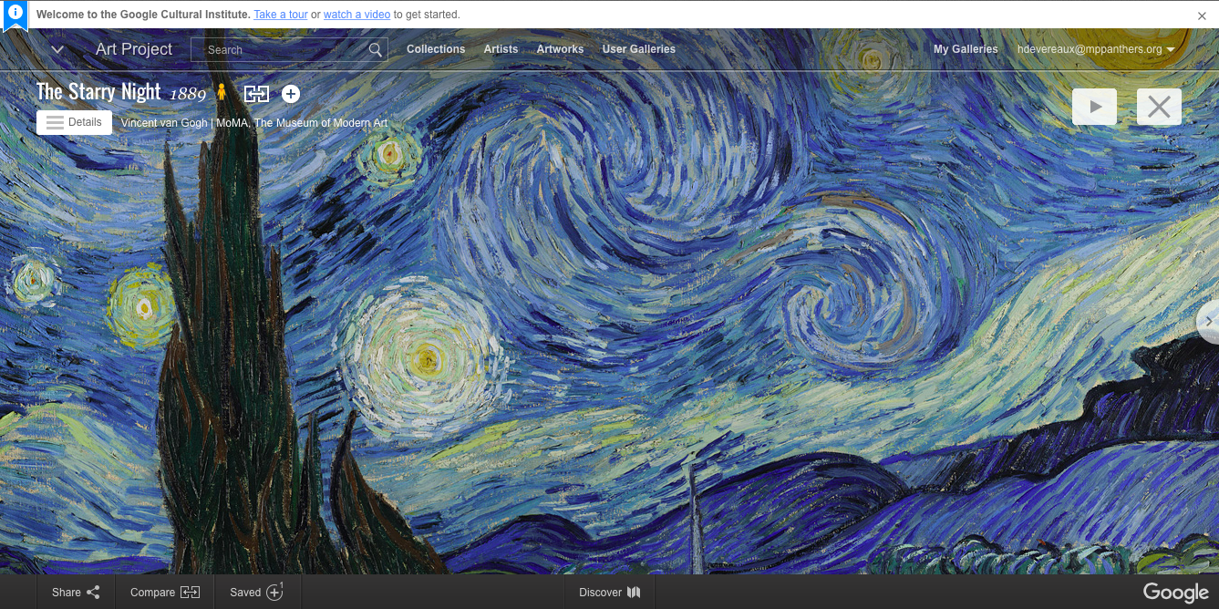
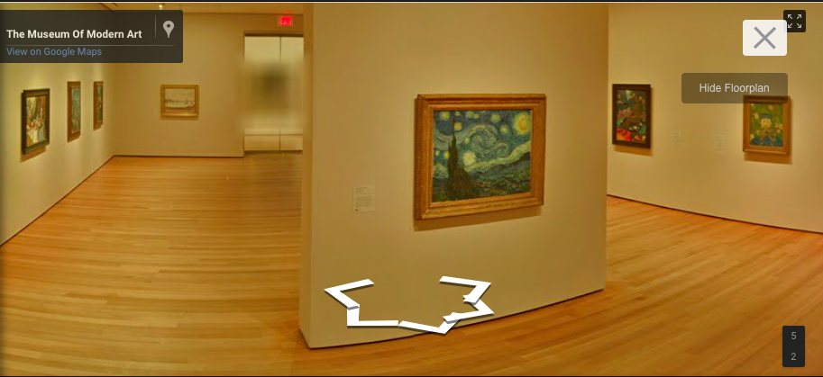
Impact on the Visual & Performing Arts Classrooms
Google Cultural Institute - Google Art Project
Notes:
Hayley Devereaux

Slide 24
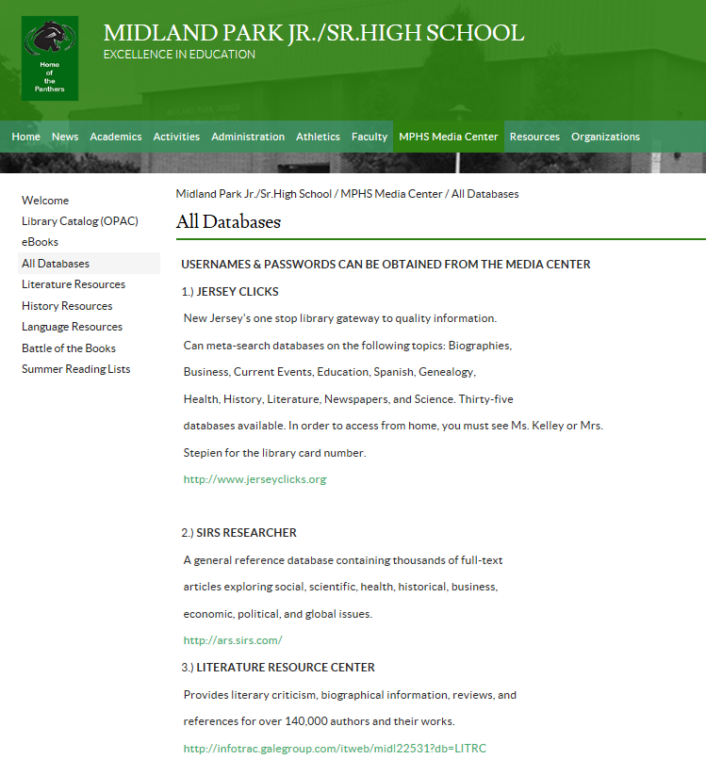
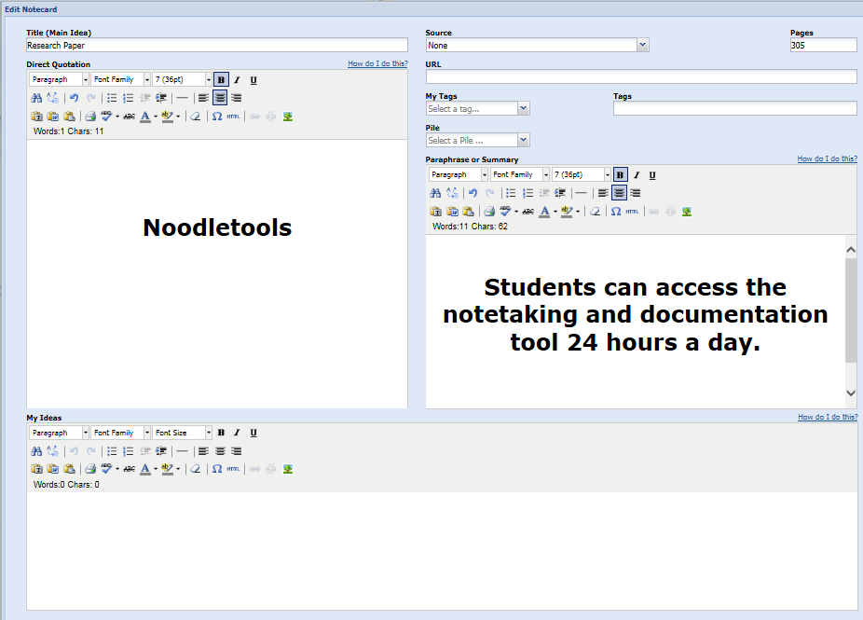
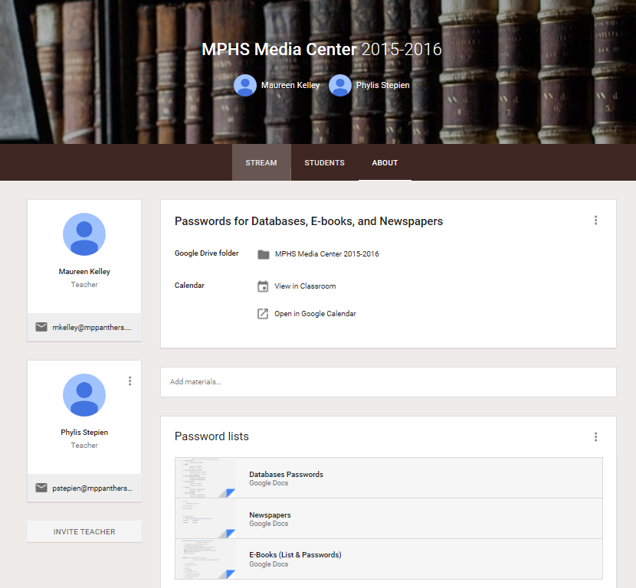
Impact on the Media Center
Access database, E-book, and newspaper passwords with the MC Google Classroom

Slide 25
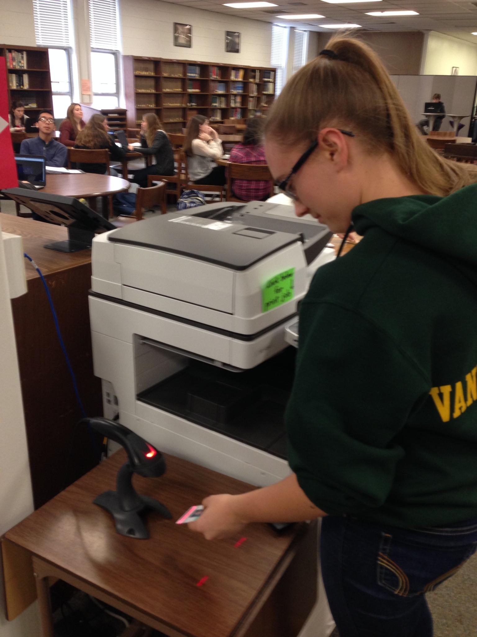
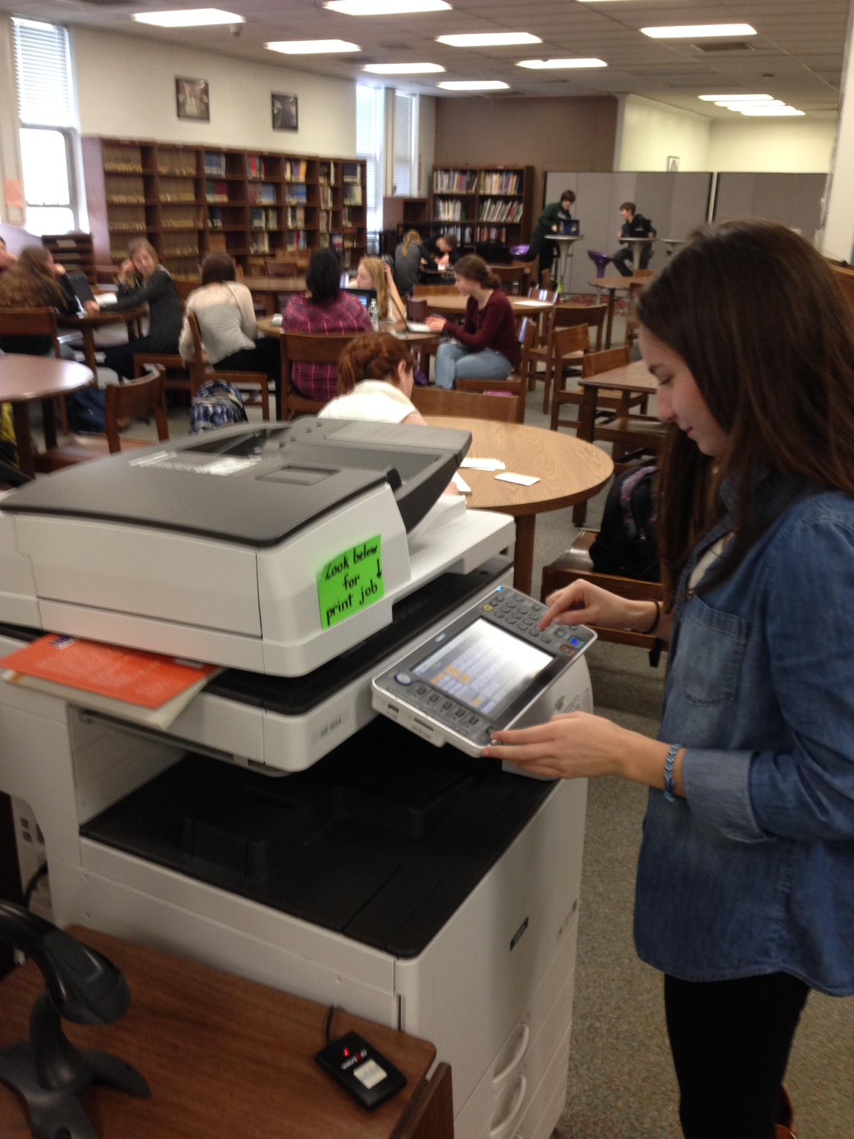
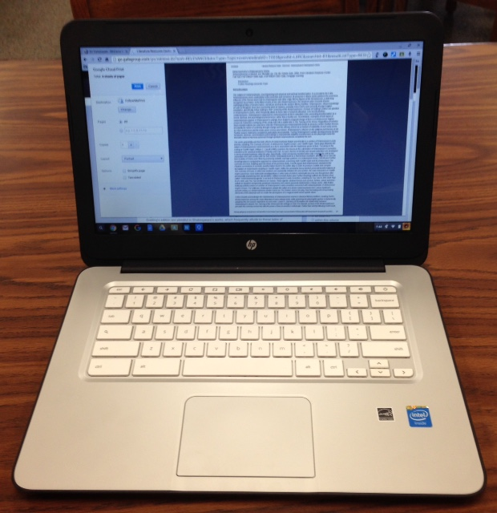
Impact on the Media Center
Assist students with “Follow Me Print”
and other device functions

Slide 26
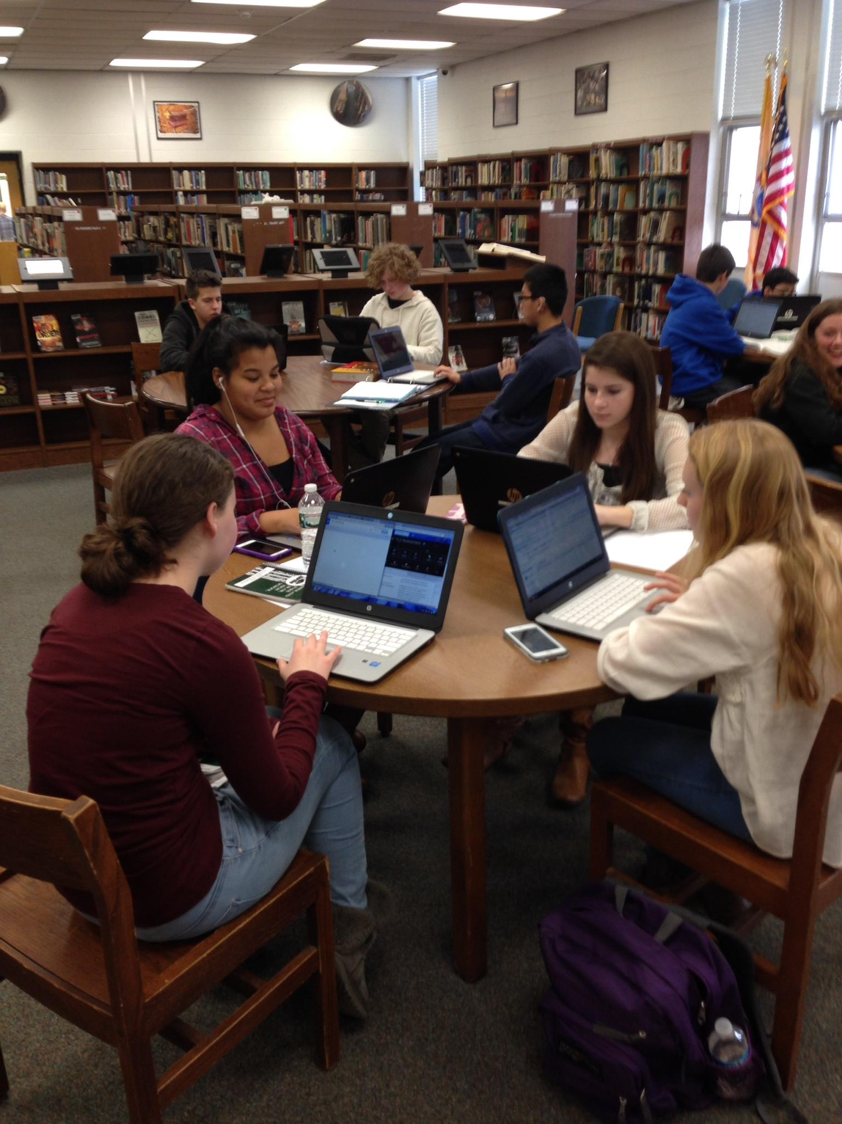
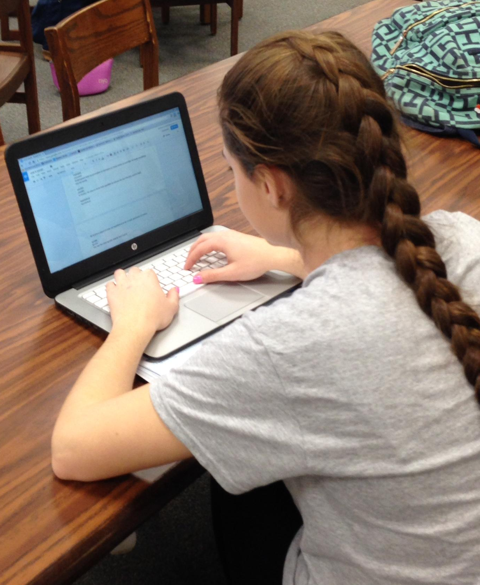
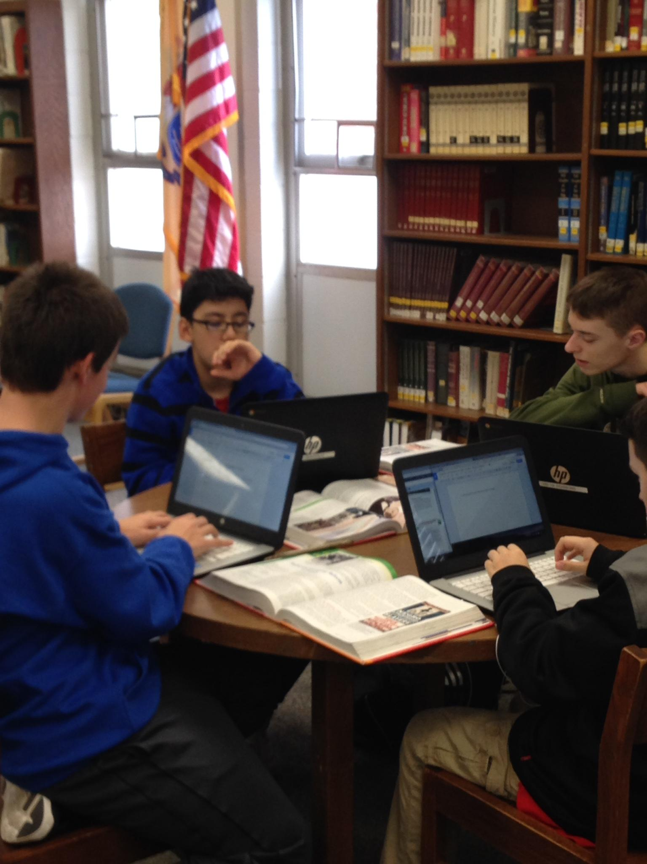
Impact on the Media Center
Finding a computer at lunch used to be difficult. Now, students are finding table space limited.

Slide 27
Students’ Experiences
The Chromebooks are so easy to use! My Chromebook has everything saved on it so that I just log in and I can open gmail by a click of a button.
They provide resources that I need to get my work done.
They allow me to do homework in school that I would otherwise have to do at home.
Used in every class.
It's better than all the notes and papers in my backpack. It would just be disorganized.
Not as heavy as conventional laptops.
I can do work on the go.

Slide 28
2016 and Beyond ….
Notes:
Melissa
21st Century learners require classroom instruction and tools that will prepare them to face the challenges of an evolving social and technological climate.
Therefore, schools must adapt in order to help students compete in a global workforce, and promote higher order thinking (i.e. synthesis, analysis, and evaluation), which is necessary for higher education.
Student assessments utilizing technology allow teachers to provide instruction that meets students’ diverse needs and interests, as well as promote engagement and creativity.
Additionally, increased communication and collaboration with teachers and classmates provide greater opportunities for access to and retention of curricular goals.
Despite these changes, the curriculum and Standards remain the same. Chromebooks provide teachers a delivery system to provide every student access to the curriculum in order to prepare them for the realities of higher education and the workforce.

